Slide 1
Spatiotemporal Data Management and Analytics High Dimensional Indexing and Search
By Prof Xiaofang Zhou, Dr Lei Li and Dr Pingfu Chao
University of Queensland

Slide 2
Learning Modules
 | Date | Lecture | Lecturer
1 | 22/6 | Course Introduction and RDBMS Review | Prof Xiaofang Zhou
2 | 22/6 | Introduction to Spatial Databases
3 | 23/6 | Spatial Data Organisation | Dr Lei Li
4 | 23/6 | Spatial Query Processing
5 | 24/6 | Managing Spatiotemporal Data | Dr Pingfu Chao
6 | 24/6 | Managing High Dimensional Data | Dr Lei Li
 | 25/6 | 端午节
7 | 26/6 | Advanced Topic: Route Planning in Road Networks | Dr Lei Li
8 | 26/6 | Future Trends, Course Review and Discussions | All
 |  | Revision Period
 | 9 July | Final Report Due

Slide 3
Readings
Christian Böhm, Stefan Berchtold and Daniel Keim: “Searching in High-dimensional Spaces: Index Structures for Improving the Performance of Multimedia Databases”, ACM Computing Surveys 33 (3), 2001.
Other papers on X-Tree, Pyramid Technique, VA-file and iDistance.

Slide 4
Why Indexing?
To locate the data quickly!
Problem: Very large data size
Query processing time should not increase linearly with the DB size
A balanced tree structure can reduce search time (IO costs)
Problem: Complex data and queries
The CPU cost for some basic operation is no longer negligible
Goal: To have a most effective mechanism to prune the search space
Benefit: Reduce I/O & CPU cost

Slide 5
Design Principles
Simple in design
Efficient in disk access/CPU time
Ease of integration into existing DBMS
It’s very hard to add a new indexing structure into a DBMS
Better chance to be practically useful if building on top of a mature and commercially available indexing method (e.g.. B+-tree & R-tree)
Must support efficient updates (insert/delete/update operations)

Slide 6


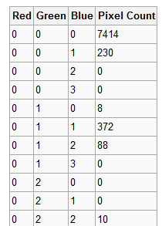
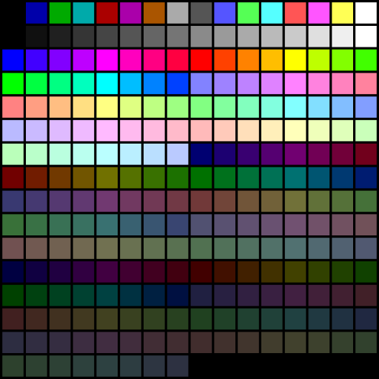
High-Dimensional Feature Space
Picture elements in digital images
Represented by <red, green, blue>
Black: <0, 0, 0>
Orange: <255,165,0>
Pixel
Img = <7414, 230, 0, 0, … >
256 color palette – 256D color space

Slide 7




High-Dimensional Feature Space
f₁ : <0.336,0.130,0.023,0.331,0.132,0.000,0.120,0.181>
f₂ : <0.331,0.123,0.028,0.338,0.008,0.011,0.132,0.181>
f₃ : <0.331,0.116,0.028,0.345,0.101,0.179,0.133,0.181>
……
f_{n} : <0.331,0.102,0.021,0.336,0.009,0.000,0.009,0.192>
High-dimensional data points
NN-dist
NN
High-D Feature Space

Slide 8
High-Dimensional Indexing
Indexing high-dimensional feature vectors
Cost factors
I/O cost: Disk page accesses
CPU cost: Computation of similarity/distance
As dimensionality increases, the portion of CPU cost in total response time increases too
This is different from traditional databases, where only I/O costs are considered

Slide 9
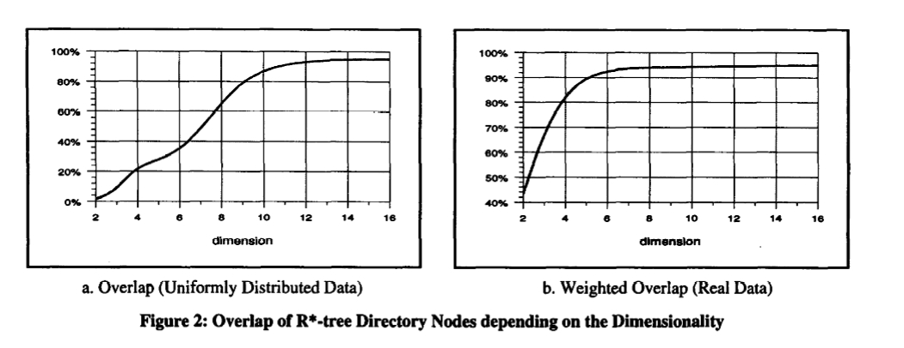
Overlap in R* Tree
Aims to minimize the overlap
Overlap: more than one branch need to be expanded
Dimensionality and Overlap
(Overlap: % of space covered by more than one R-tree node)
(Weighted Overlap: % of data objects in overlapping space)

Slide 10
‘Dimensionality Curse’
The performance of an index degrades rapidly as dimensionality increases, and eventually underperforms linear scan!
However, linear scan needs to search the whole data file - affected volume is 100%
Then query processing time will increase at least linearly with the DB size
When the size of dataset is very large, loading the whole data into memory is unlikely
Even if this is possible, it’s still too expensive to scan all the data

Slide 11
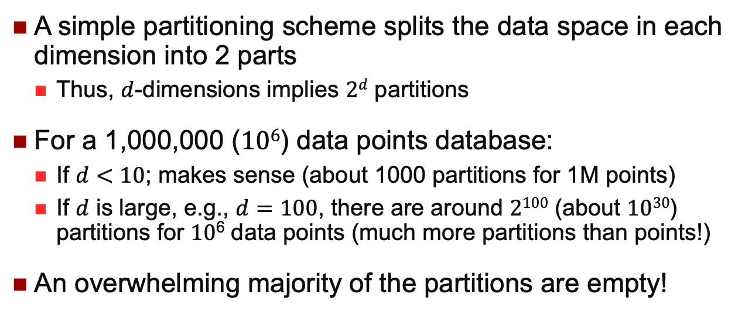
Too Many Partitions
A simple partitioning scheme splits the data space in each dimension into 2 parts
Thus, $d$-dimensions implies $2d$ partitions
For a 1,000,000 ($106$) data points database:
If $d<10$; makes sense (about 1000 partitions for 1M points)
If $d$ is large, e.g., $d=100$, there are around $2100$ (about $1030$) partitions for $10$⁶ data points (much more partitions than points!)
An overwhelming majority of the partitions are empty!

Slide 12
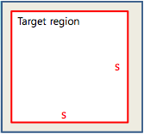
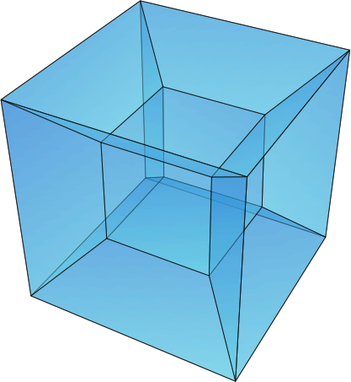
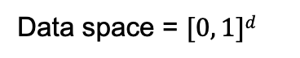
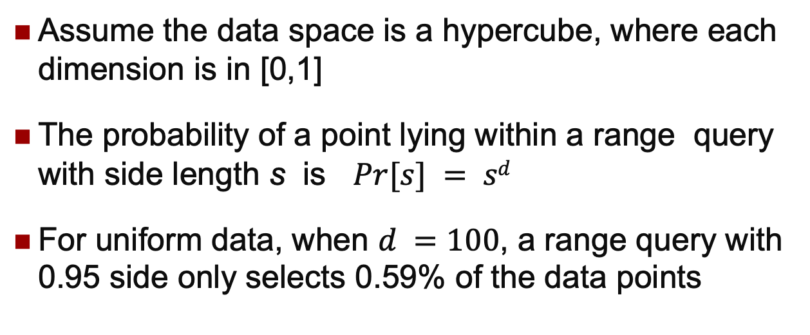
Too Few Points
Data space = $[0, 1]d$
Assume the data space is a hypercube, where each dimension is in [0,1]
The probability of a point lying within a range query with side length s is $Pr⁡[s] = sd$
For uniform data, when $d =100$, a range query with 0.95 side only selects 0.59% of the data points

Slide 13
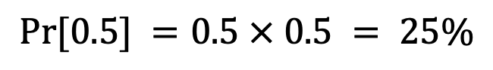
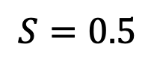
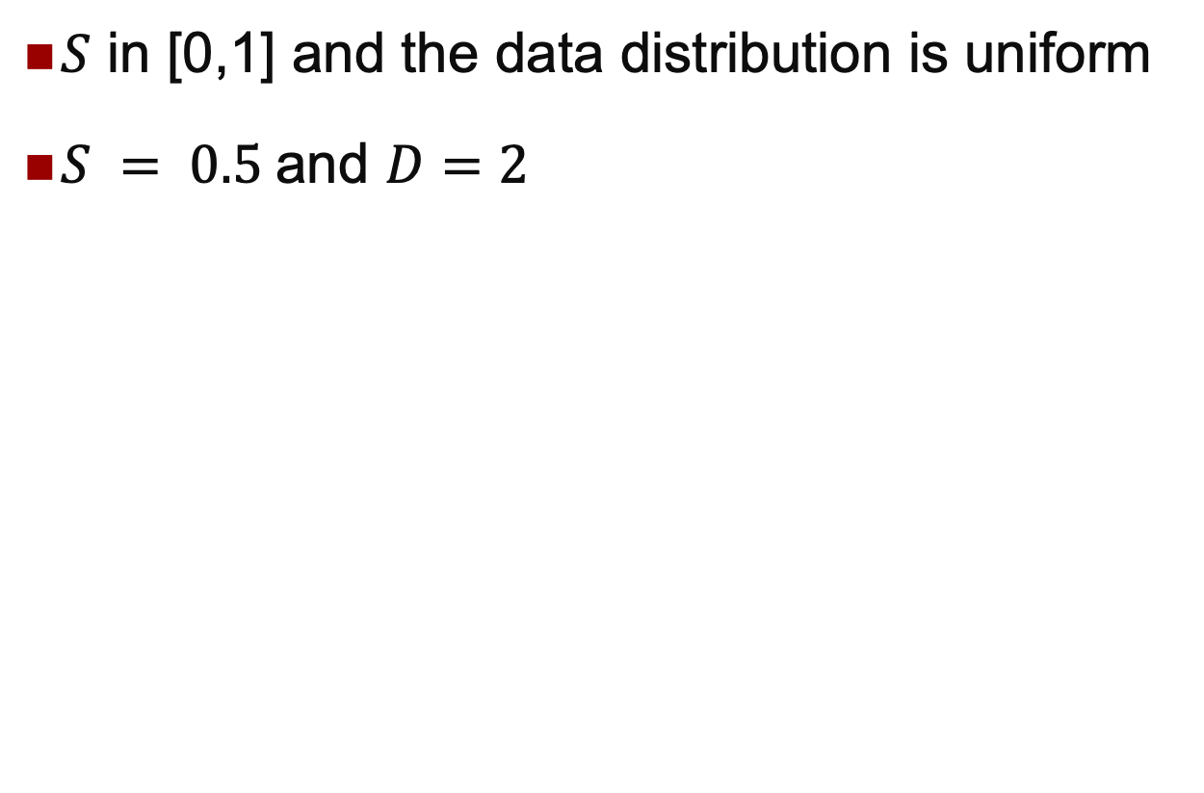
Too Few Points
$S$ in [0,1] and the data distribution is uniform
$S = 0.5$and $D=2$
$$S=0.5$$
$$Pr⁡[0.5] =0.5 × 0.5 = 25\%$$

Slide 14
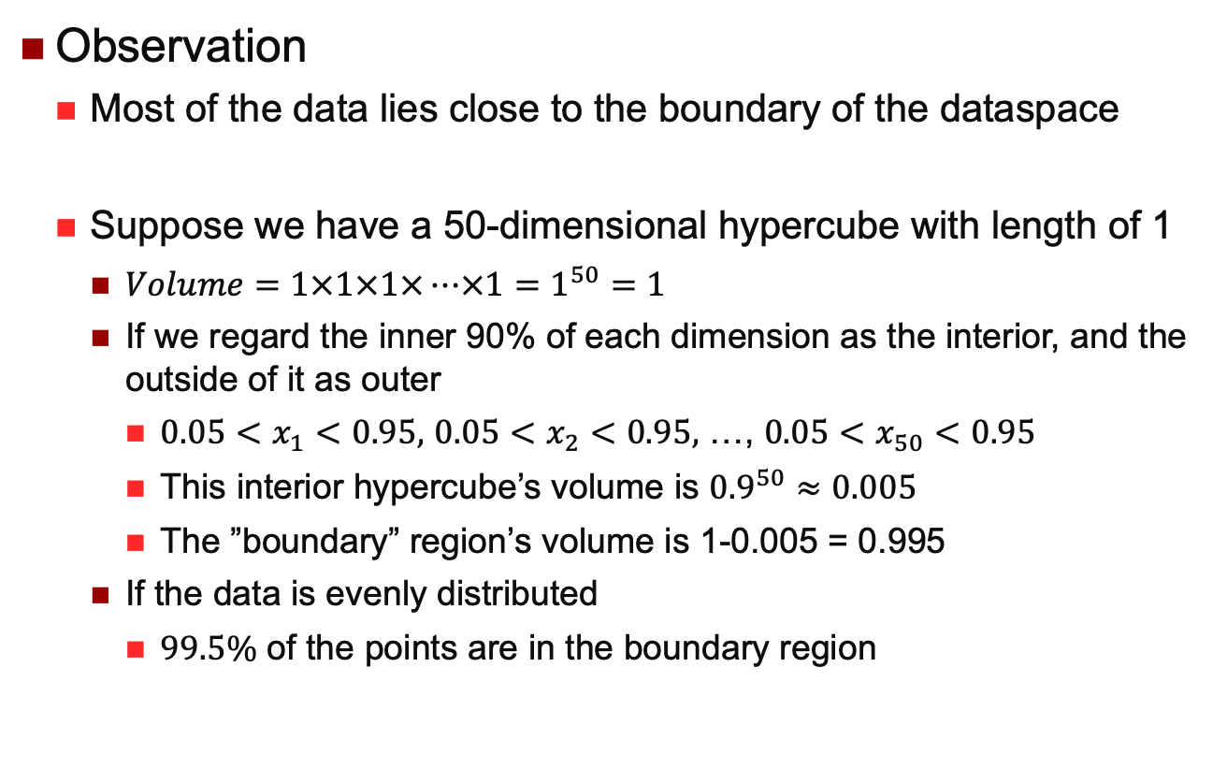
Too Few Points
Observation
Most of the data lies close to the boundary of the dataspace
Suppose we have a 50-dimensional hypercube with length of 1
$Volume=1×1×1×…×1=1^{50}=1$
If we regard the inner 90% of each dimension as the interior, and the outside of it as outer
$0.05<x_{1}<0.95,$ $0.05<x_{2}<0.95,$ …, $0.05<x_{50}<0.95$
This interior hypercube’s volume is ${0.9}^{50}≈0.005$
The ”boundary” region’s volume is 1-0.005 = 0.995
If the data is evenly distributed
$99.5\%$ of the points are in the boundary region

Slide 15
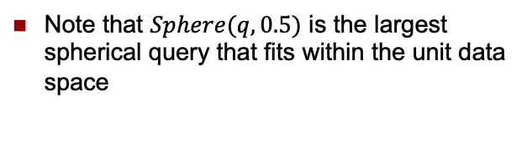
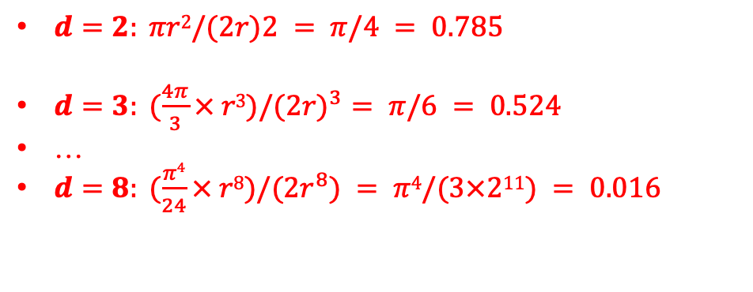
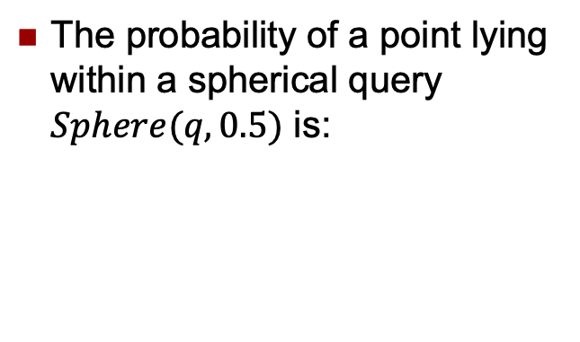
Another Look at this Problem
The probability of a point lying within a spherical query $Sphere(q, 0.5)$ is:
$d=2: πr2/(2r)2 = π/4 = 0.785$
$d=3: (\frac{4π}{3}× r3)/(2{r)}^{3}= π/6 = 0.524$
…
$d=8: (\frac{π4}{24}× r8)/(2r^{8}) = π4/(3×211) = 0.016$
q
1
Note that $Sphere(q, 0.5)$ is the largest spherical query that fits within the unit data space
100 d
50

Slide 16
The Nearest is not Near Enough
In some sense, nearly all of the high-dimensional space is "far away" from the centre
The high-dimensional unit space can be said to consist almost entirely of the "corners" of the hypercube, with almost no "middle".
Low distance contrast: as the dimensionality increases, the distance to the nearest neighbour approaches the distance to the farthest neighbour.
Difference between the nearest data point and the farthest data point reduces greatly
Notes:
When d approach infinity, dist(min, max) approaches to 0

Slide 17
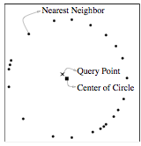
Question:
Is the nearest neighbour meaningful in a high-D space?
It depends on the data distribution
Nothing can be done for uniform data.
Generally, real data are not uniformly distributed, but exhibit certain clusters, trends or skewness.

Slide 18
Many Methods…
Hierarchical Tweaking
X-Tree
SS-Tree, SR-Tree, Ball-Tree
Transformation based
Pyramid Technique
iDistance [VLDB’01]
Optimal one-dimensional distance B+ tree [SIGMOD’05]
Dimensionality reduction
Local Dimensionality Reduction (LDR)
Multi-level Mahalanobis based Dimensionality Reduction (MMDR)
Data compression based
Vector Approximation (VA-File) [VLDB’98]
Hybrid of tree-like structure and data compression
Independent Quantization (IQ-tree)
Local Digital Coding (LDC)
Approximate search
Locality Sensitive Hashing (LSH)
Vector Quantization (VQ-index)
Spatial Approximation Sample Hierarchy (SASH)
Notes:
VA-File is VLDB Test-of-time award paper

Slide 19
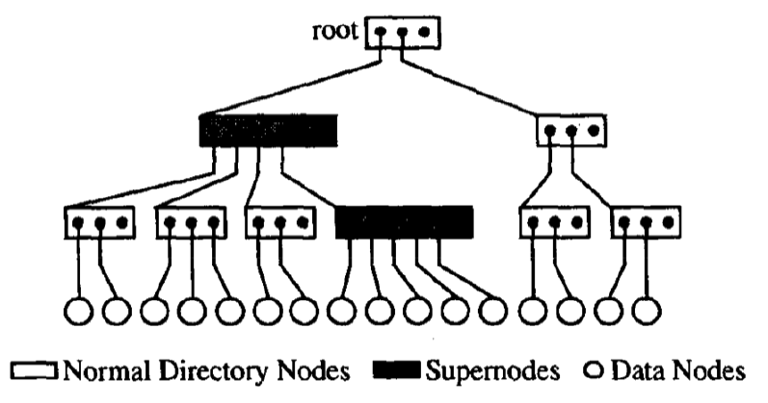
X-Tree
Variation of R-Tree
Avoid overlap in the directory, when we cannot find a good partition
In high dimensional, linear organization of the directory is more efficient
Due to the high overlap, most of the directory has be to be searched
So don’t split when it overlap is high
Tree Nodes
Data Node
Normal Directory Node
Super Node
Large directory nodes of variable size
Arbitrary number of blocks
Avoid split in the directory that would result in an inefficient directory
[1] The X-tree: An Index Structure for High-Dimensional Data, VLDB, 1996

Slide 20
X-Tree
Insertion
If no split occurs, update the size of MBR
Split a sub-node
Split the node topologically when overlap is low
Minimize the combination of perimeter and overlap
When the overlap is high, overlap minimal split
If the number of MBRs in one of the partitions is below a given threshold (unbalanced)
Stop splitting and extend to a Supernode

Slide 21
X-Tree
Overlap-Minimal Split
For point data
It is always possible to find an overlap-free split
It is not possible to guarantee that the two sets are balanced
Determine a dimension according to which all MBRs have been split previously
Split History
The dimension according to which an MBR has been split
Which new MBRs have been created by this split

Slide 22
X-Tree
Split Tree
Leaf Node: MBR
Internal Node: Nodes that have been split into new MBRs
Record the dimension that was used to split
All MBRs in any split tree have one split dimension in common: the root node
Compromise between the hierarchy and sequential access
A
2
2
2
2
A’
B
A’
5
A’
5
4
5
B’
C
1
C
A’’
E
1
C
B’’
D
B’’
D

Slide 23
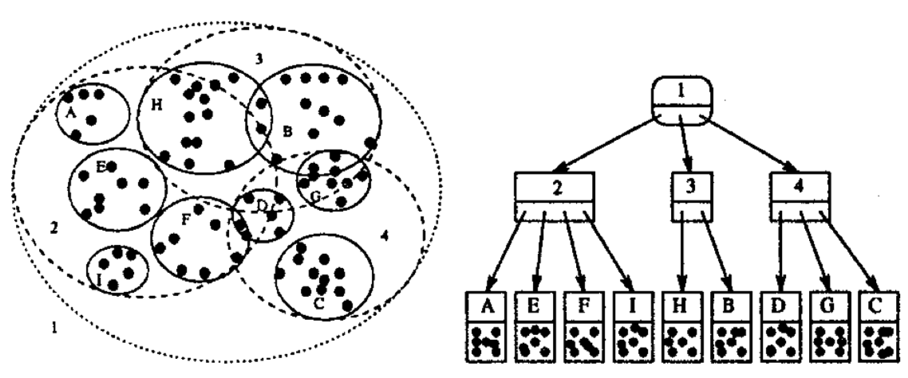
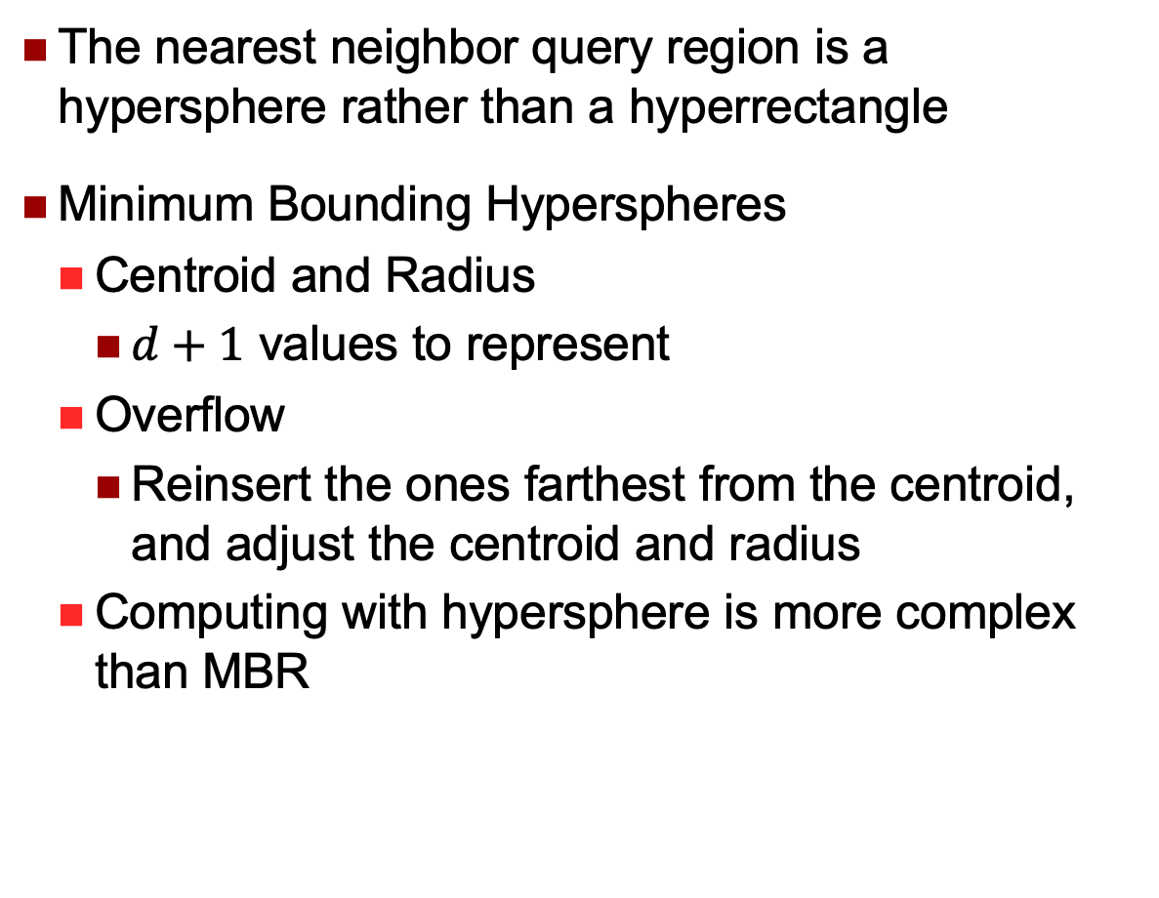
SS-Tree
The nearest neighbor query region is a hypersphere rather than a hyperrectangle
Minimum Bounding Hyperspheres
Centroid and Radius
$d+1$ values to represent
Overflow
Reinsert the ones farthest from the centroid, and adjust the centroid and radius
Computing with hypersphere is more complex than MBR

Slide 24
TV-Tree
Limit the number of attributes that are tested at each level of the index hierarchy
Dimensions / Attributes have different importance
Detect with PCA (Principal Component Analysis )
Use the ones have high discrimination power
When some of the attributes become less powerful in discrimination, replace them with other attributes
When all the attributes are used, TV-Tree is reduced to R-Tree / SS-Tree

Slide 25
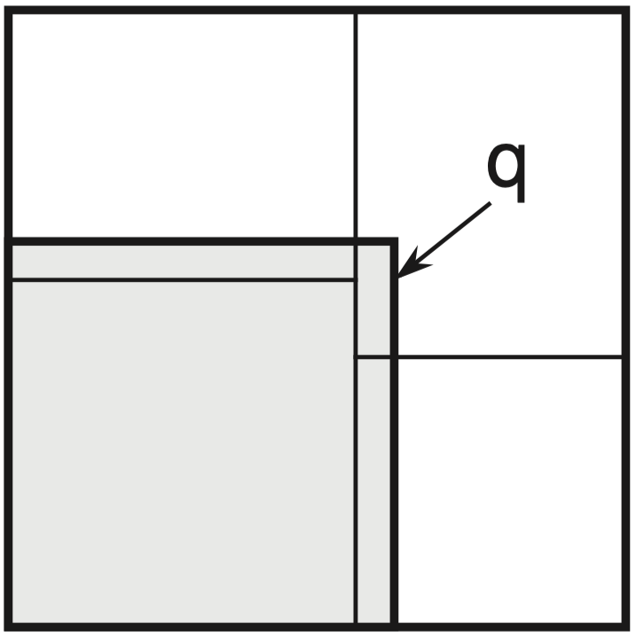
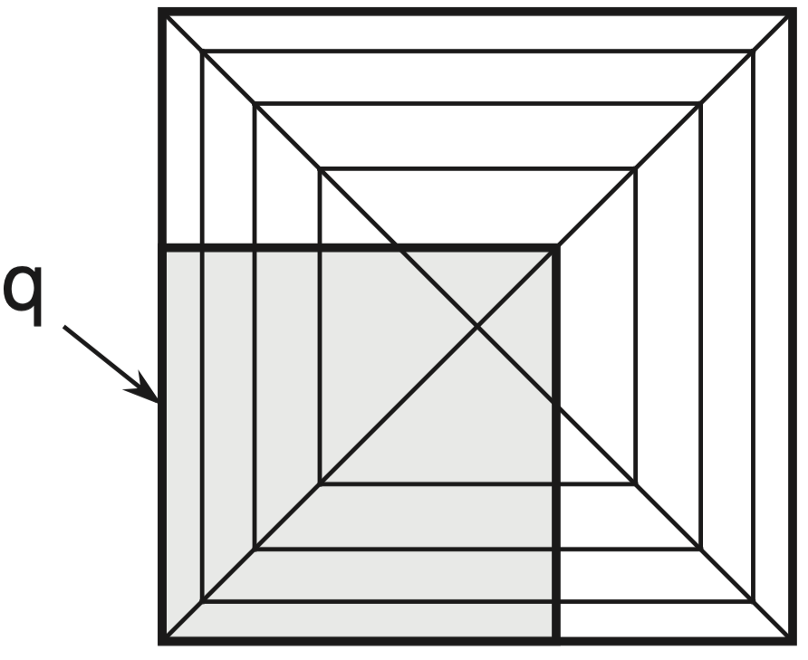
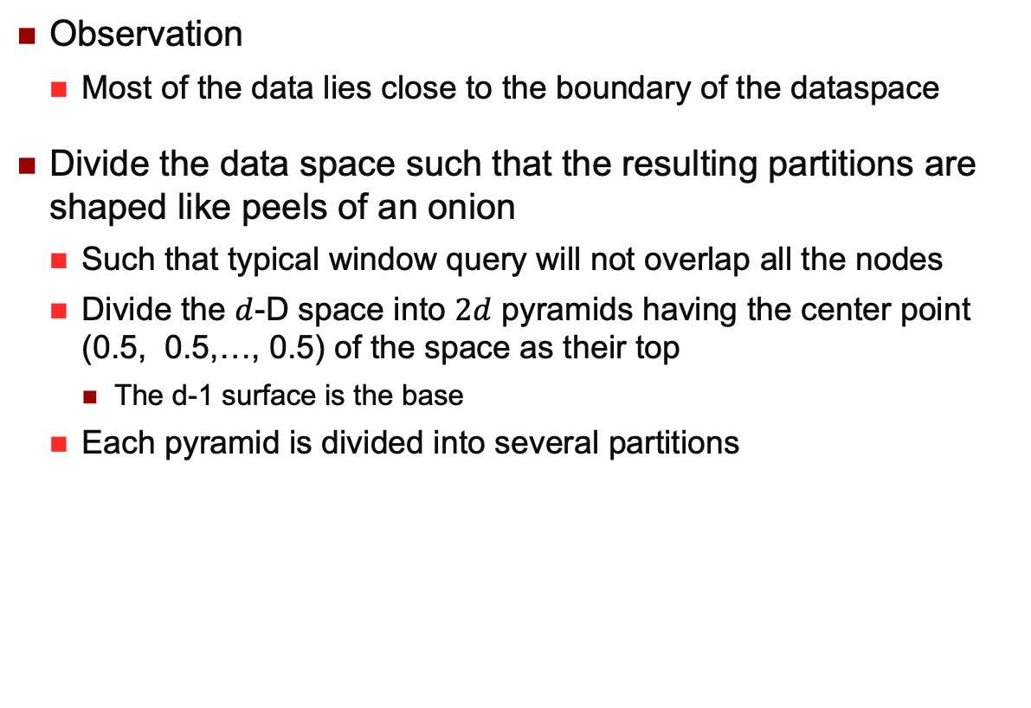
Pyramid Technique
Observation
Most of the data lies close to the boundary of the dataspace
Divide the data space such that the resulting partitions are shaped like peels of an onion
Such that typical window query will not overlap all the nodes
Divide the $d$-D space into $2d$ pyramids having the center point (0.5, 0.5,…, 0.5) of the space as their top
The d-1 surface is the base
Each pyramid is divided into several partitions
Center Point
Pyramid
Partition
d-1 dimensional surface
[1] The Pyramid -Technique: Towards Breaking the Curse of Dimensionality, SIGMOD, 1998

Slide 26

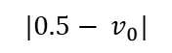

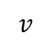
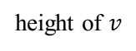
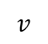

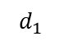
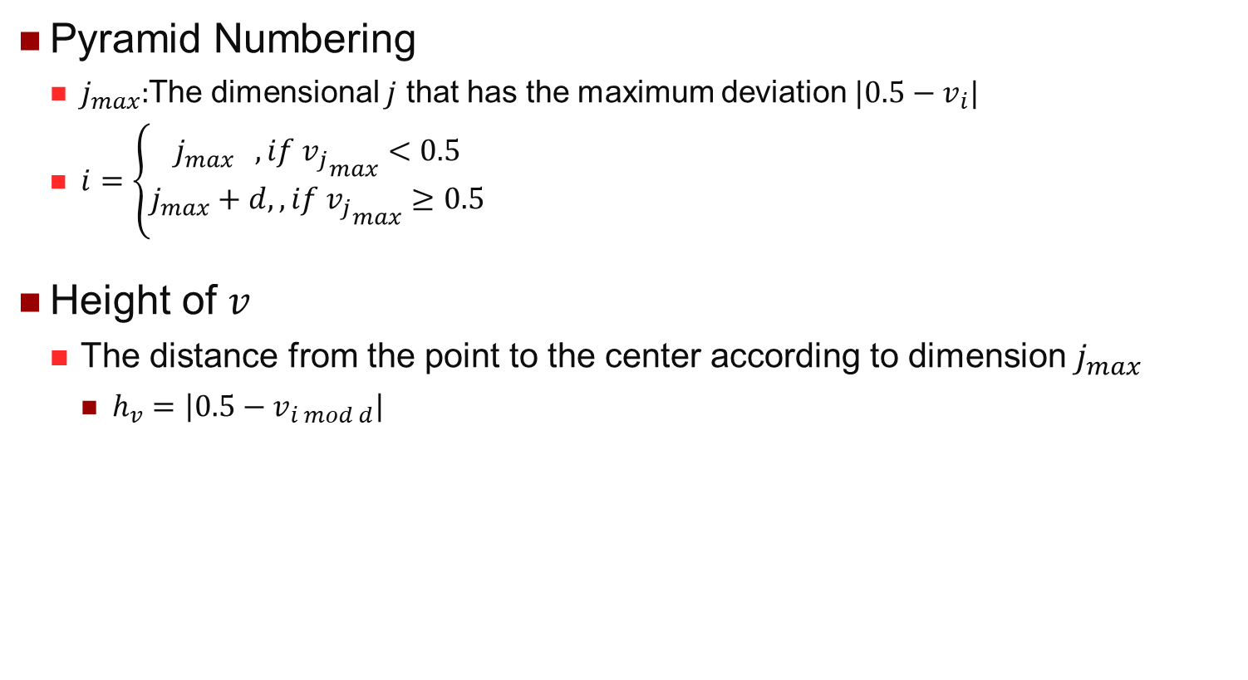
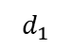
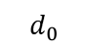

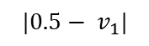
Pyramid Technique
Pyramid Numbering
$j_{max}:$The dimensional $j$ that has the maximum deviation $|0.5−v_{i}|$
$i=\left\{\begin{aligned}j_{max} , if {v_{j}}_{max}<0.5 \\ j_{max}+d,, if {v_{j}}_{max}≥0.5\end{aligned}\right.$
Height of $v$
The distance from the point to the center according to dimension$j_{max}$
$h_{v}=\left|0.5−v_{i mod d}\right|$
$$d_{1}$$
$$d_{1}$$
$$p_{3}$$
$$p_{0}$$
$$p_{2}$$
height of $v$
$$|0.5− v_{1}|$$
$$p_{1}$$
$$v$$
$$v$$
$$d_{0}$$
$$|0.5− v_{0}|$$
$$d_{0}$$

Slide 27

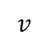

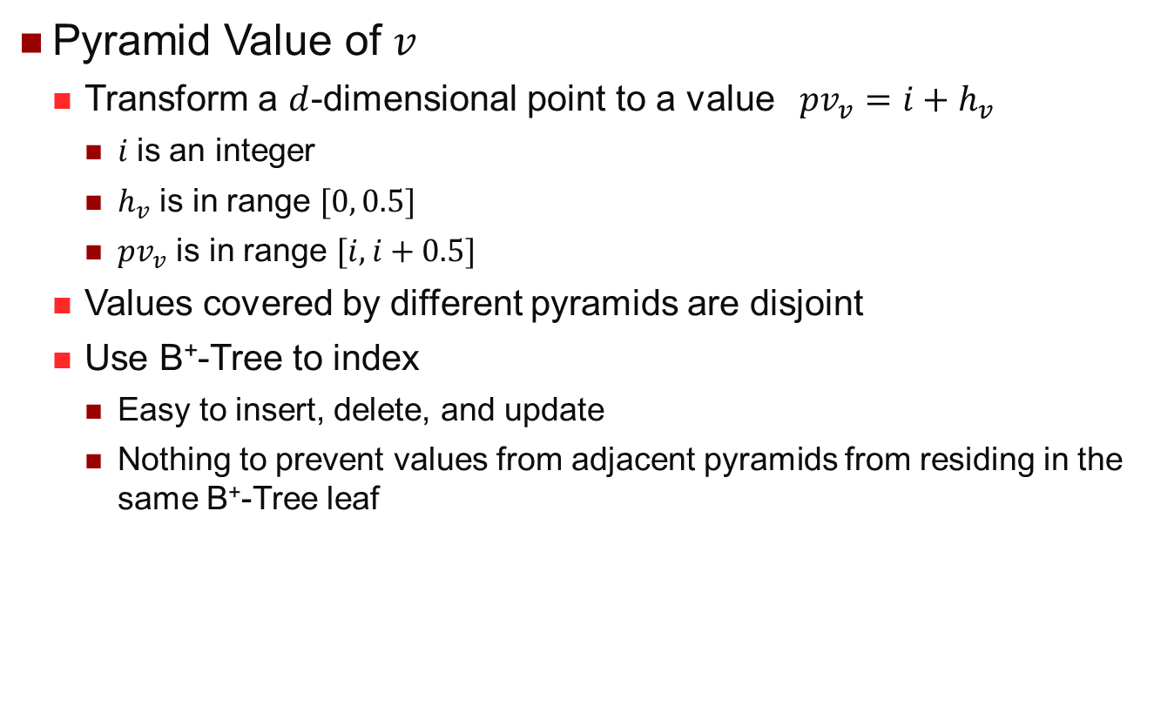
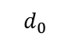

Pyramid Technique
Pyramid Value of $v$
Transform a $d$-dimensional point to a value $pv_{v}=i+h_{v}$
$i$is an integer
$h_{v}$ is in range $[0, 0.5]$
$pv_{v}$ is in range $[i,i+0.5]$
Values covered by different pyramids are disjoint
Use B⁺-Tree to index
Easy to insert, delete, and update
Nothing to prevent values from adjacent pyramids from residing in the same B⁺-Tree leaf
$$d_{1}$$
$$p_{3}$$
$$p_{0}$$
$$p_{2}$$
height of $v$
$$p_{1}$$
$$v$$
$$d_{0}$$

Slide 28
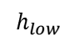
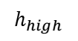
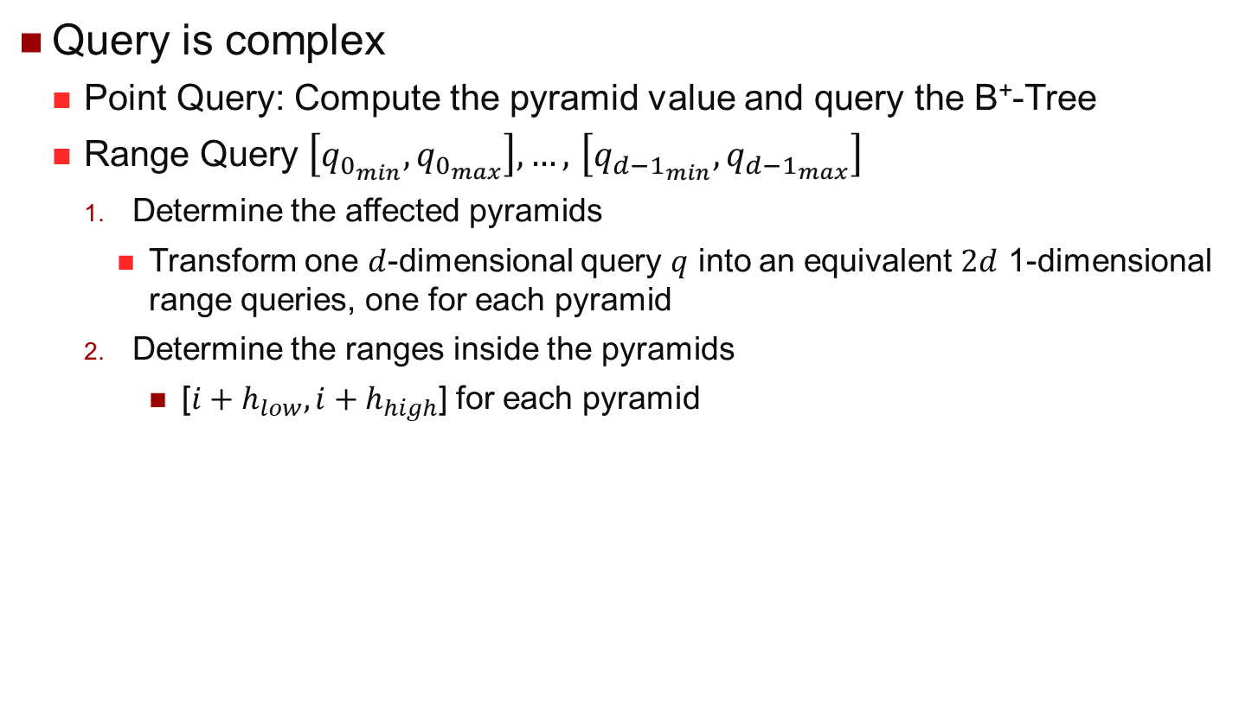
Pyramid Technique
Query is complex
Point Query: Compute the pyramid value and query the B⁺-Tree
Range Query $\left[q_{0_{min}},q_{0_{max}}\right],…,$ $\left[q_{{d−1}_{min}},q_{{d−1}_{max}}\right]$
Determine the affected pyramids
Transform one $d$-dimensional query $q$ into an equivalent $2d$ 1-dimensional range queries, one for each pyramid
Determine the ranges inside the pyramids
[$i+h_{low},i+h_{high}$] for each pyramid
$$h_{low}$$
$$h_{high}$$

Slide 29
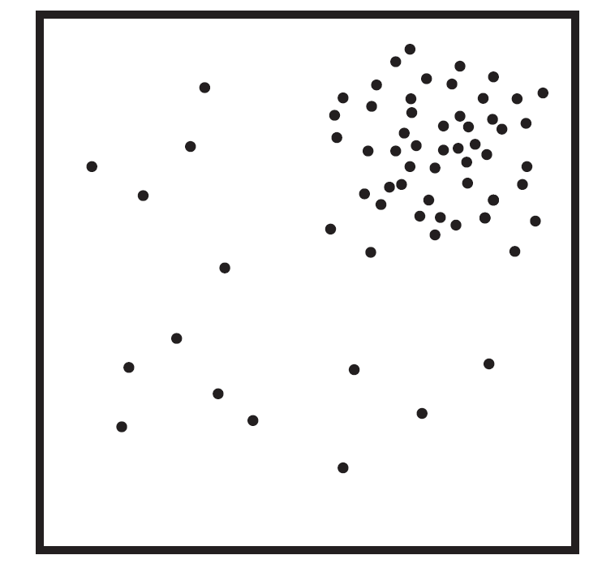
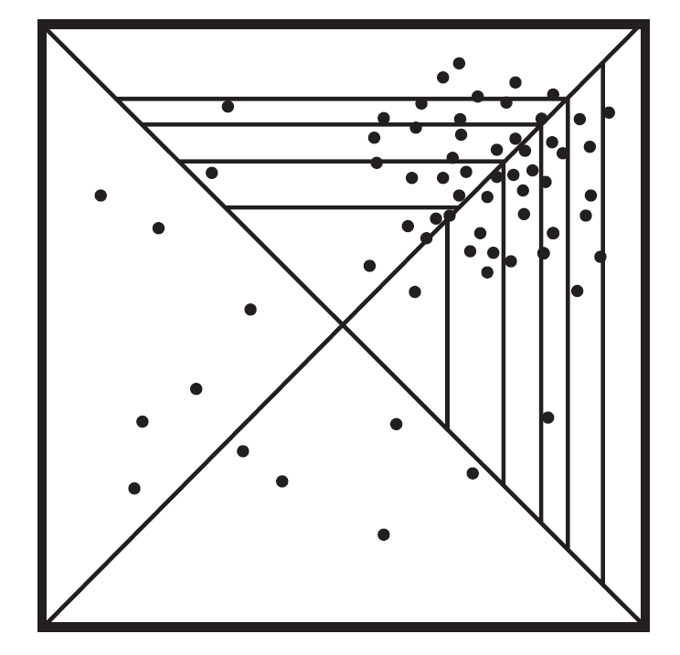
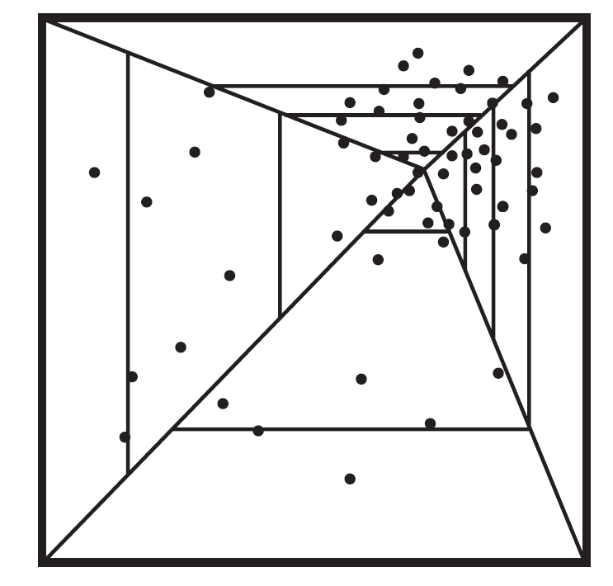
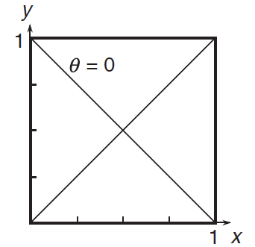
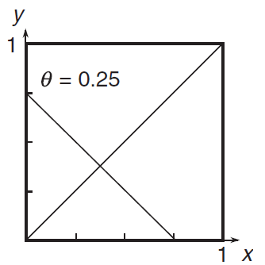
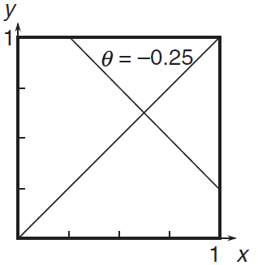
Pyramid Technique
The effectiveness is sensitive to query position
Require uniform distribution
Query Region
Accessed Region

Slide 30
Vector Approximation (VA) File
In High-D spaces, all tree-based indexing structures examine a very large fraction of leave nodes
Since the space of nodes heavily overlap
Better to scan the whole data set and avoid performing disk seek operations altogether
Sequential scan is much faster than random read
Let go of the hierarchies !
Natural question: how to speed up linear scan?
If read all of them is inevitable…
Using approximation to compress vector data, to reduce the amount of data to exam during the search
[1] A quantitative analysis and performance study for similarity-search methods in high-dimensional spaces, VLDB, 1998 VLDB Test-of-time award paper

Slide 31
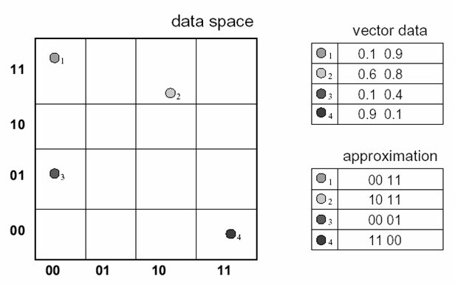
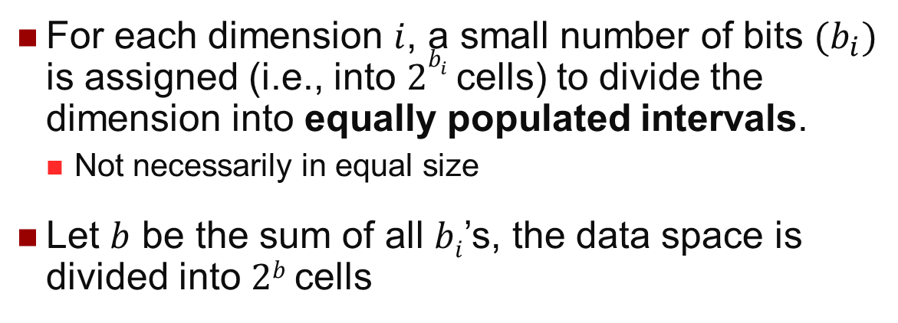
Basic Idea
For each dimension $i$, a small number of bits $(b_{i})$ is assigned (i.e., into $2b_{i}$ cells) to divide the dimension into equally populated intervals.
Not necessarily in equal size
Let $b$ be the sum of all $bi$’s, the data space is divided into $2b$ cells
1st dim: 2 bits and 2nd dim: 2 bits
2²×2²=2²⁺²=2⁴=16 cells

Slide 32
Building VA-file
Map objects to cells
Each cell has a bit representation with length b
The VA-file itself is simply an array of bits concatenation based on the quantization of the original feature vectors.

Slide 33
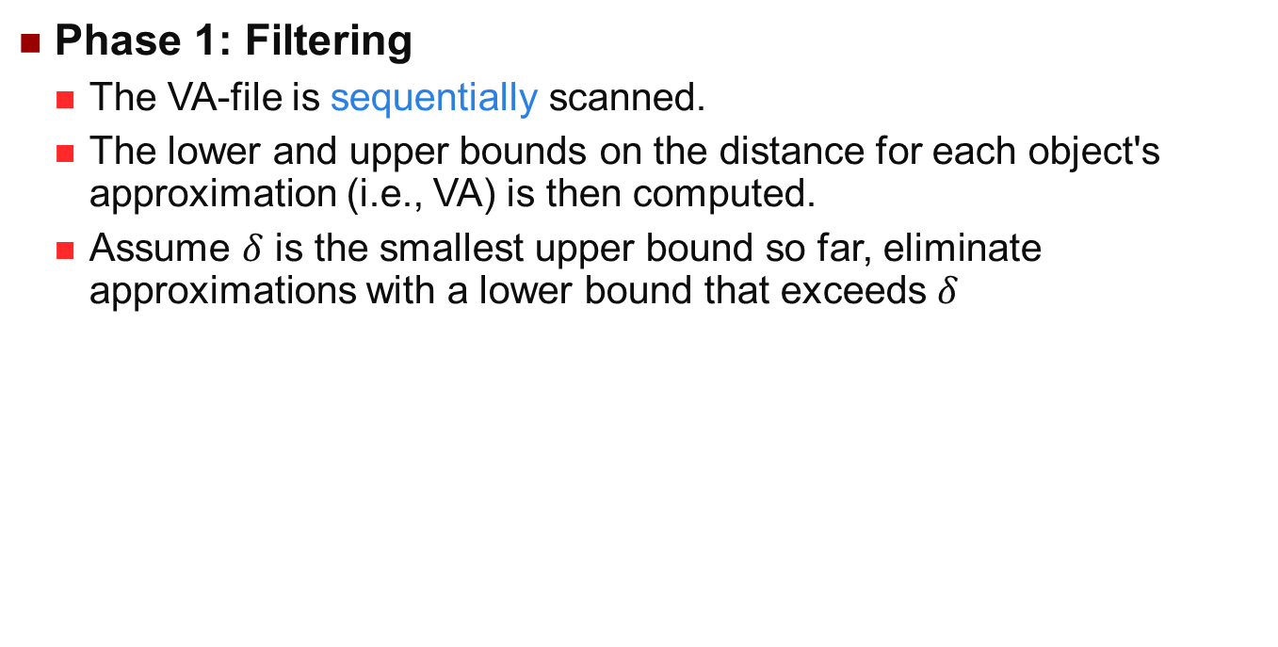
VA-file 2-Phase NN search
Phase 1: Filtering
The VA-file is sequentially scanned.
The lower and upper bounds on the distance for each object's approximation (i.e., VA) is then computed.
Assume $δ$ is the smallest upper bound so far, eliminate approximations with a lower bound that exceeds $δ$
UB
LB

Slide 34
VA-file 2-Phase NN search
Phase 2: Refine
After the filtering step, a small set of candidates remain
Candidates are sorted by lower bound
If a lower bound is encountered that exceeds the nearest distance seen so far, the VA-file method stops
UB
LB

Slide 35
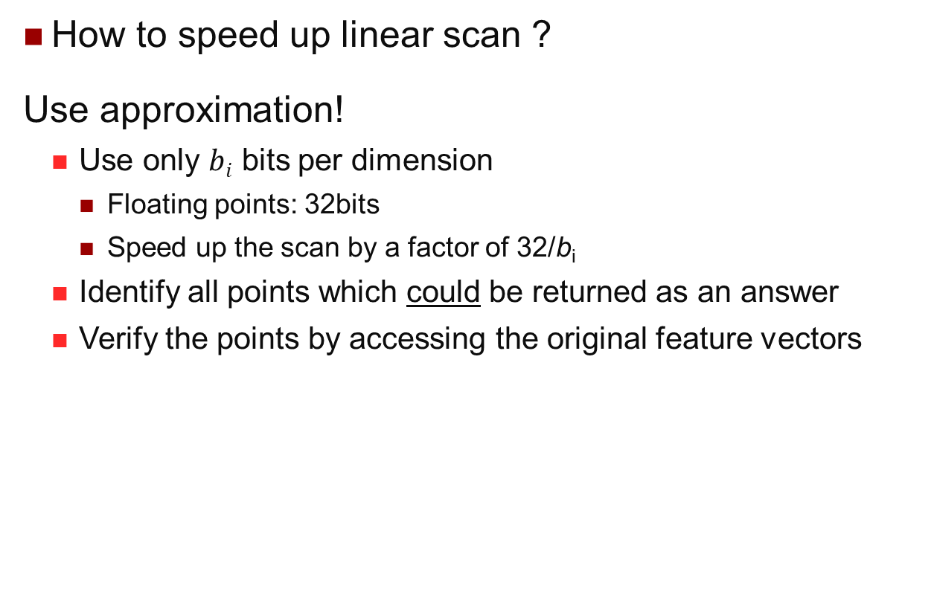
What We can Learn from VA File?
How to speed up linear scan ?
Use approximation!
Use only $bi$ bits per dimension
Floating points: 32bits
Speed up the scan by a factor of 32/b_{i}
Identify all points which could be returned as an answer
Verify the points by accessing the original feature vectors

Slide 36
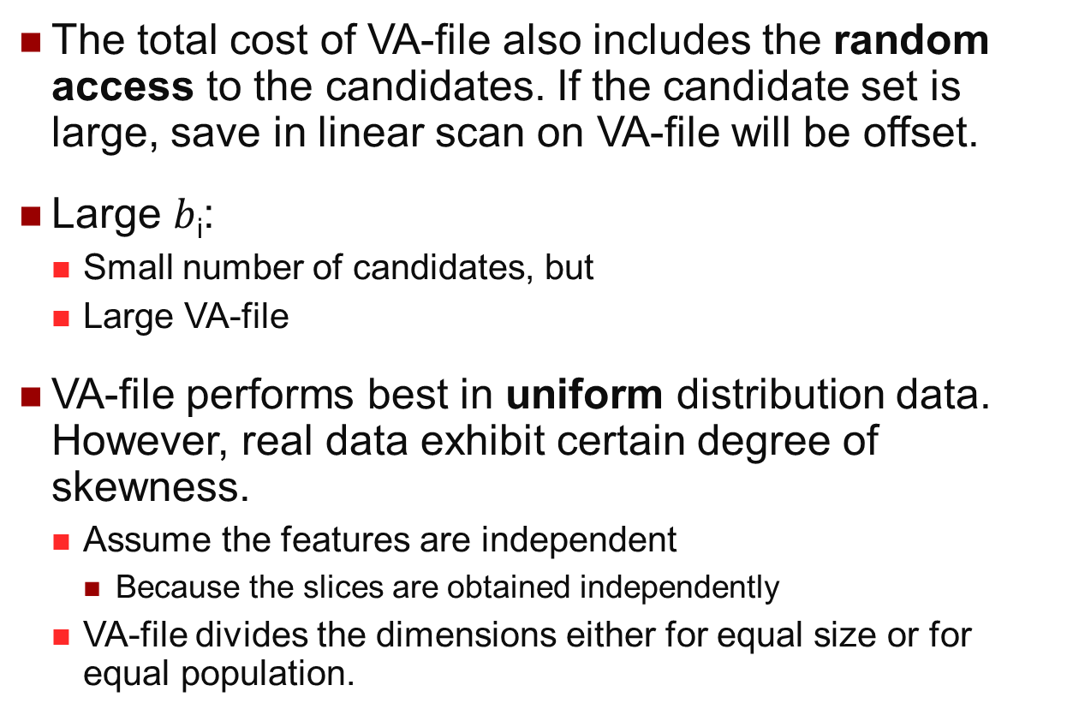
Limits of VA-file
The total cost of VA-file also includes the random access to the candidates. If the candidate set is large, save in linear scan on VA-file will be offset.
Large $b$_{i}:
Small number of candidates, but
Large VA-file
VA-file performs best in uniform distribution data. However, real data exhibit certain degree of skewness.
Assume the features are independent
Because the slices are obtained independently
VA-file divides the dimensions either for equal size or for equal population.

Slide 37
iDistance^{[1]}
iDistance is simple, but efficient
It is a distance and partition based index
It can be used for approximate search
The index can be integrated to existing systems easily
Another representative way to handle high dimensional data
[1] Indexing the Distance: An Efficient Method to KNN Search, VLDB, 2001

Slide 38
Basic Ideas
Observations
The similarity/dissimilarity between points can be derived with reference to a chose reference point
Points can be ordered based on their distance to the reference point
Distance is essentially a single dimensional value
Reuse the existing 1-D index like B+ -Tree

Slide 39
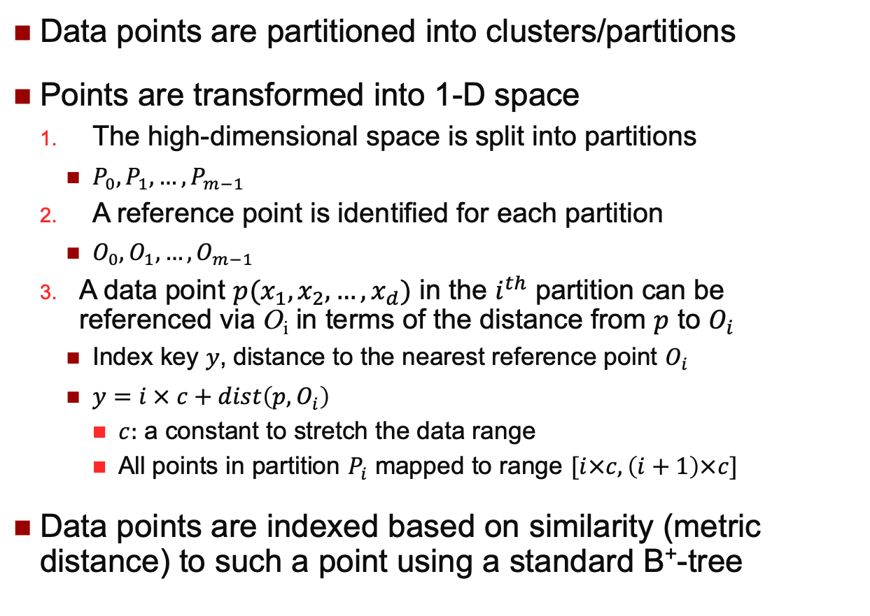
Basic Ideas
Data points are partitioned into clusters/partitions
Points are transformed into 1-D space
The high-dimensional space is split into partitions
$P_{0},P_{1},…, P_{m−1}$
A reference point is identified for each partition
$O_{0},O_{1},…, O_{m−1}$
A data point $p(x_{1},x_{2},…,x_{d})$ in the $i^{th}$ partition can be referenced via O_{i} in terms of the distance from $p$ to $O_{i}$
Index key $y$, distance to the nearest reference point $O_{i}$
$y=i × c+dist\left(p,O_{i}\right)$
$c:$ a constant to stretch the data range
All points in partition $P_{i}$ mapped to range $[i×c, \left(i+1\right)×c]$
Data points are indexed based on similarity (metric distance) to such a point using a standard B⁺-tree

Slide 40
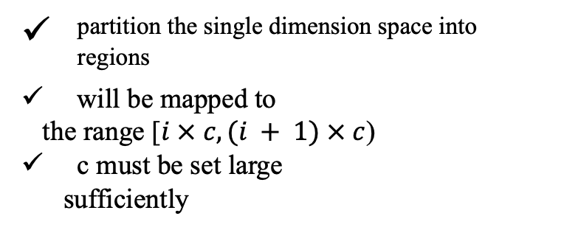

Indexing Points Based on Similarity
Indexing points based on similarity
Reference/anchor points
partition the single dimension space into regions
will be mapped to
the range [$i × c, (i + 1) × c$)
c must be set large
sufficiently
d
O3
O1
O2
...
S1
S1+d
S2
S3
Sk
c
Sk+1
Assume: $Dist(p_{1}, O_{1}) = 5$, $Dist(p_{2}, O_{2}) = 5$
We set c = 100
$iDist(p_{1}) = 105$and $iDist(p_{2}) = 205$

Slide 41
The Triangle Inequality Property
Given a query q, for each point p in the $i^{th}$ partition:
With a Query Range of to satisfy
^{The distance between} ^{and the farthest} ^{point in the partition:}
if
this partition needs to be scanned for the range query search, else we can eliminate it from consideration
The final search space:
p
q

Slide 42







Example
$$dist\left(O_{3},q_{2}\right)−querydist(q_{2})$$
$$dist\left(O_{1},q_{1}\right)+querydist(q_{1})$$
$$dist_max⁡(O_{3})$$
$$dist\left(O_{1},q_{1}\right)−querydist(q_{1})$$
$$dist\left(O_{2},q_{2}\right)−querydist(q_{2})$$
$$dist_max⁡(O_{2})$$
Notice: all points along the same radius have the same value after transformation to distance
Points with the same values are not necessarily close to each other

Slide 43
KNN Search
For each partition, its minimal and maximal distance to the Reference Point are recorded to utilize the search.
Iterative range queries are used in kNN searching.
Scanning the auxiliary structure to identify the centroids whose data space overlaps with the query sphere (q, r) with a small r
The auxiliary structure: {(O, min, max)}
r is enlarged incrementally
data space
min
o
max

Slide 44
Graphical Illustration
A range in B+-tree
Searching region is enlarged till getting K NN.

Slide 45
Selection of Clusters/Partitions
Equal Partitioning:
Effective if data is uniformly distributed
Data Points are often correlated!
Clusters:
Small number: More points are likely to have similar distance to a given reference point
Large number: More clusters are likely to overlap and incurs additional traversal and searching

Slide 46
Summary
“Dimensionality curse” is a real problem which is very hard to handle
It is counter-intuitive that similarity search can be meaningless with more information captured
It is also counter-intuitive that sophisticated indexing structures may not even as efficient as a linear scan over the entire database
People often use pivot-points based indexing and data compression to deal with high dimensional data
This is still an open problem, with most solutions which are either data dependent or domain specific

